Slide 1

STUDY ON CERVICAL CANCER
Sankhadeep Kundu
Abubakkar Siddiq
A.Sai Mahathi

Slide 2
Plan of action
DESCRIPTION
OBJECTIVES
VISUALISATION
MODELLING
CONCLUSION

Slide 3
DESCRIPTION
Cervical cancer, a type of cancer affecting the lower parts of the uterus, is primarily observed in women. This dataset contains valuable information regarding various risk factors associated with cervical cancer, alongside the outcomes of different diagnostic tests. The dataset consists categorical variables such as age, sexual behaviour, contraceptive usage, history of sexually transmitted infections, and results from tests including Hinselmann, Schiller, Citology, and Biopsy. Notably, certain variables, such as number of sexual partners, age at first sexual intercourse, number of pregnancies, smoking status, use of hormonal contraceptives, presence of an IUD, and history of STDs etc have missing values. Among these, "STDs: Time since first diagnosis" and "STDs: Time since the last diagnosis" exhibit the highest percentage of missing values at 91.72%. The study aims to comprehend the causes of cervical cancer in females and predict the results of cancer diagnostic tests based on fresh insights into personal details, sexual behaviour, and medical history.
MOST OF THE DATA IS CATEGORICAL[BINARY VALUES]

Slide 4
OBJECTIVES
To establish a prediction model that says a patient is prone to cervical cancer based on their medical history & personal details

Slide 5
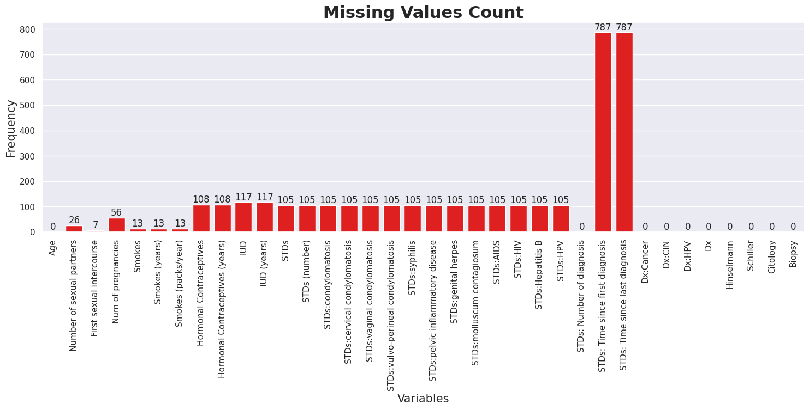
MISSING VALUES VISUALISATION

Slide 6
Handling the Missing values in the data
The cutoff for the missing values was considered to be 15. So the rows exceeding more than or equal to 15 missing values have been removed. A total of 105 rows were removed from the dataset.
The remaining rows which have the missing values have been imputed with the “mode” of the respective characteristic.

Slide 7
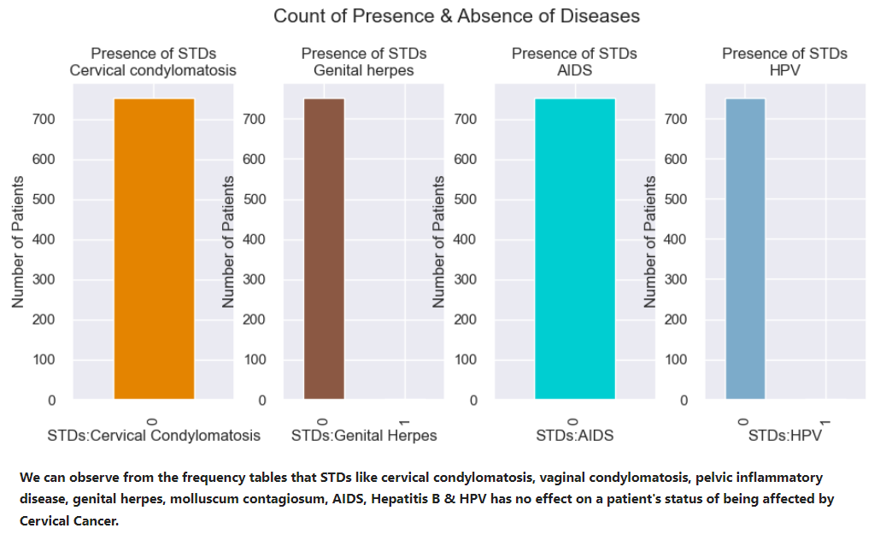
What is the Data speaking?
'STDs:cervical condylomatosis'
'STDs:vaginal condylomatosis'
'STDs:pelvic inflammatory disease'
'STDs:genital herpes'
'STDs:molluscum contagiosum'
'STDs:AIDS'
'STDs:Hepatitis B'
STDs:HPV
The following variables have been removed from the dataset as the patients have no effect on their status of cervical cancer with regard to this .
We can observe from the frequency tables that STDs like cervical condylomatosis, vaginal condylomatosis, pelvic inflammatory disease, genital herpes, molluscum contagiosum, AIDS, Hepatitis B & HPV have no effect on a patient's status of being affected by Cervical Cancer.

Slide 8
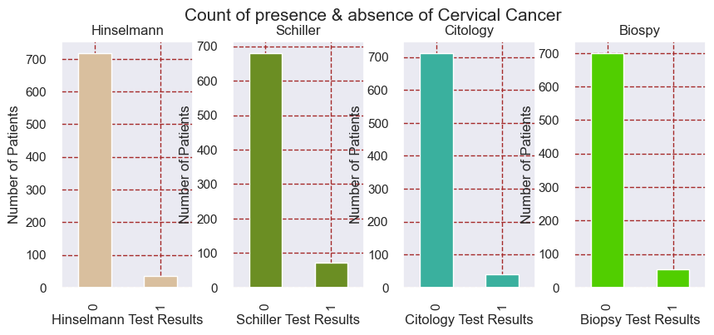
CERVICAL CANCER PRESENCE COUNT

Slide 9
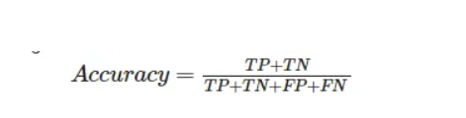
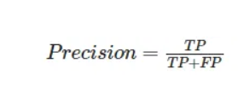
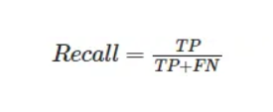
Metrics for model
Accuracy: the proportion of true results among the total number of cases examined.
Precision: used to calculate how much proportion of all data that was predicted positive was actually positive
Recall: used to calculate how much proportion of actual positives is correctly classified

Slide 10
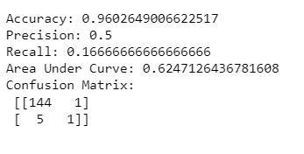
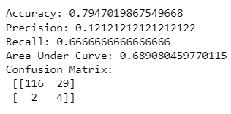
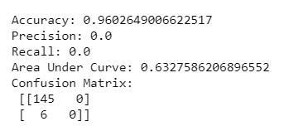
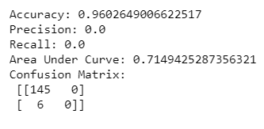
Decision Tree random forest
Predicted test results for Hinselmann
NAÏVE BAYES
LoGISTIC REGRESSION

Slide 11
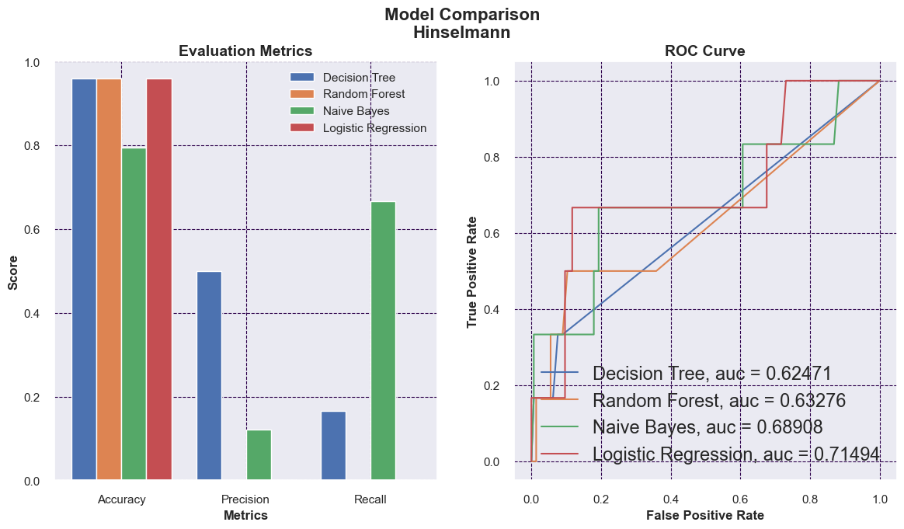
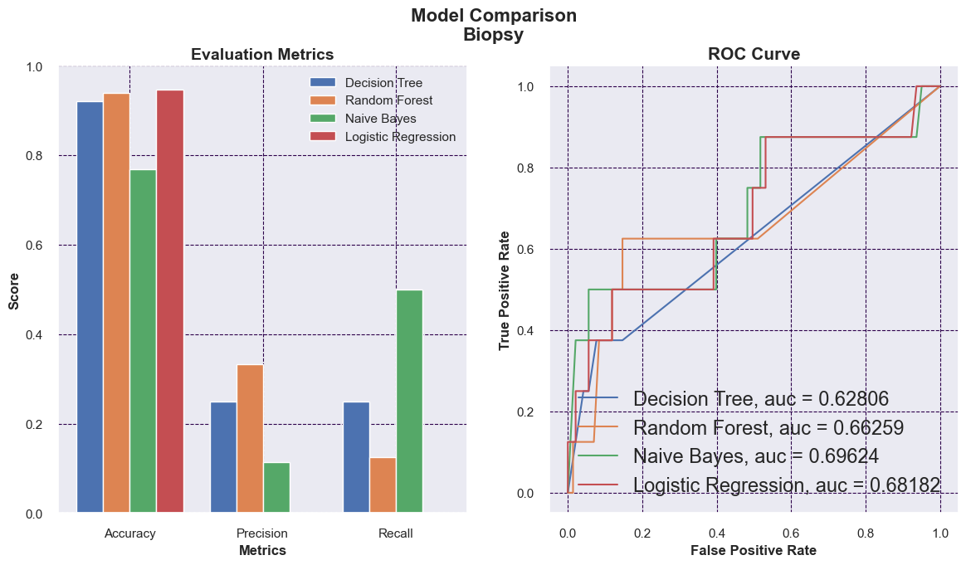
MODEL COMPARISON HINSELMAN | BIOPSY

Slide 12
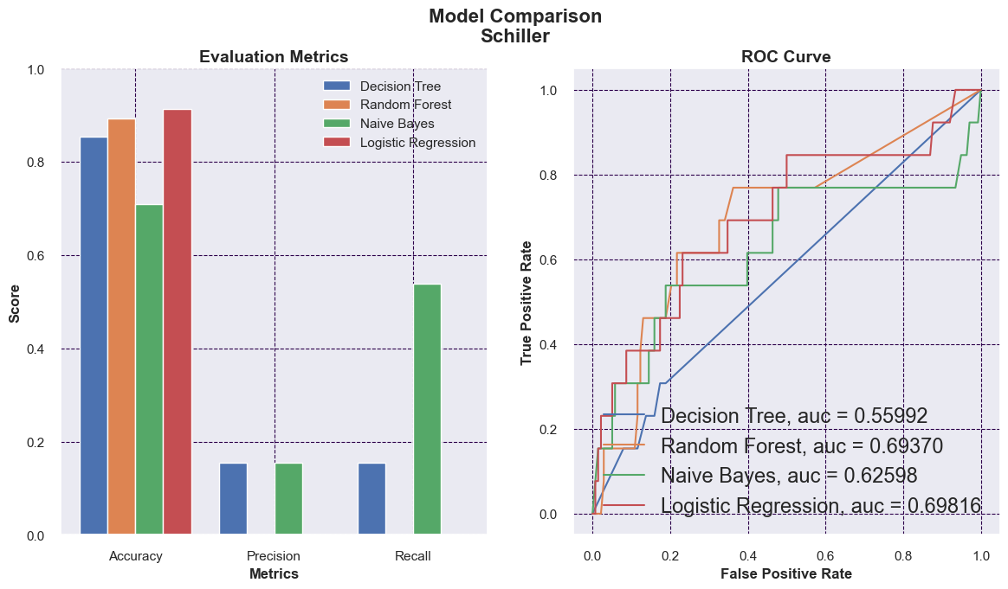
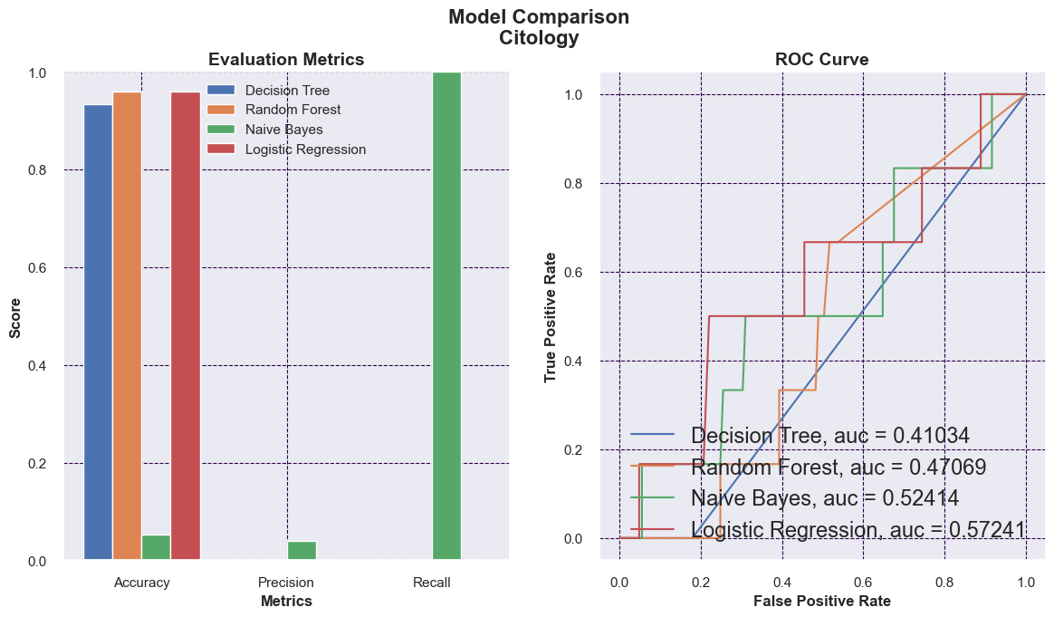
MODEL COMPARISON SCHILLER | CITOLOGY

Slide 13
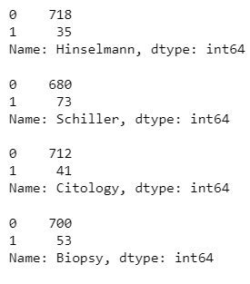
Conclusion
Through Exploratory Data Analysis it can be interpreted that several STDs & lifestyle habits of patients are insignificant factors of the dataset affecting the output of Cervical Cancer Tests.
From the four models used Naïve Bayes performs the best than others as they have the lowest number of False Negative values in the confusion matrix.
As the dataset has a clear class imbalance and therefore accuracy wouldn't be a correct metric to go to for the evaluation of the models.
Instead, we choose recall as the suitable metric for evaluation as it tells what proportion of predicted values were actually positive.
The dataset contains fewer patients who were detected with cancer. Hence, the model has lesser prediction power due to imbalanced data. The absence of disease was indicated by code 0, while the presence of disease is indicated by code 1 & its count throughout the entire data is shown below.

Slide 14
THANK YOU

